Slide 1
Topics
Concurrency
Definitions & Theory
Race conditions
Design patterns

Slide 2
Concurrency
Concurrency is the ability of a system to manage multiple tasks independently, where tasks can interleave their execution over a period of time.
It’s not parallelism!!
Concurrency => Multiple tasks making progress, but not necessarily simultaneously. Example: A single-core CPUswitching between tasks
Parallelism => Multiple tasks executing literally at the same time on multiple cores/processors
Why it matters
I/O-Heavy Operations Network requests, database queries, file operations often have long wait times
Multi-Core Systems Modern processors have multiple cores; single-threaded programs utilize only one
User Responsiveness Applications must handle multiple user interactions simultaneously
Server Applications Must handle thousands of concurrent client connections

Slide 3
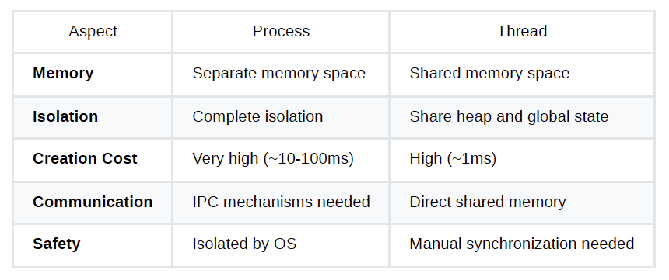
Concurrency - How
NEW
We need OS tools to make it.
Concurrent actors:
Processes
Threads
Virtual threads => implemented by runtime
READY
RUNNING
BLOCKED
TERMINATED

Slide 4
Race conditions
A race condition occurs when the outcome of a program depends on the timing of thread execution, leading to unpredictable behavior.
Thread A: withdraw(500)
Thread B: withdraw(600)
class BankAccount {
private int balance = 1000;
public void withdraw(int amount) {
if (balance >= amount) {
// Critical window: // another thread could read
// balance here
balance = balance - amount;
// and execute concurrently
}
}
public int getBalance() {
return balance;
}
}
Possible timeline of disaster:
Time | Thread A | Thread B | Memory
t1 | read balance (1000) in CPU | - | balance = 1000
t2 | subtract 500 | - | balance = 1000
t3 | - | read balance (1000) in CPU | balance = 1000
t4 | write 500 to memory | - | balance = 500
t5 | - | subtract 600 | balance = 500
t6 | - | write 400 | balance = 400

Slide 5
Locks
First fix approach to race conditions => critical sections or explicit locks
import java.util.concurrent.locks.ReentrantLock;
class BankAccount {
private ReentrantLock lock = new ReentrantLock();
private int balance = 1000;
public void withdraw(int amount) {
lock.lock();
try {
if (balance >= amount) {
balance = balance - amount;
}
} finally {
lock.unlock(); // MUST unlock, even on exception
}
}
public int getBalance() {
return balance;
}
}
class BankAccount {
private int balance = 1000;
public synchronized void withdraw(int amount) {
if (balance >= amount) {
balance = balance - amount;
}
}
public int getBalance() {
return balance;
}
}
Advantages of locks over synchronized:
Explicit control (lock/unlock)
Timed lock acquisition
Interruptible locking
Multiple condition variables
BEWARE OF DEADLOCKS!

Slide 6
Threads – the basics
class WorkerRunnable implements Runnable {
private String name;
public WorkerRunnable(String name) {
this.name = name;
}
@Override
public void run() {
System.out.println(name + " executing");
}
}
public class RunnableDemo {
public static void main(String[] args) {
Thread t1 = new Thread(new WorkerRunnable("Worker-1"));
Thread t2 = new Thread(new WorkerRunnable("Worker-2"));
t1.start();
t2.start();
// Main thread continues immediately
t1.join();
t2.join();
}
}
class WorkerThread extends Thread {
private String name;
public WorkerThread(String name) {
this.name = name;
}
@Override public void run() {
System.out.println(name + " executing");
}
}
public class ThreadDemo {
public static void main(String[] args) {
Thread t1 = new WorkerThread("Worker-1");
Thread t2 = new WorkerThread("Worker-2");
t1.start(); // Starts new thread, calls run()
t2.start();
// Main thread continues immediately
t1.join(); // make sure that we wait for
t2.join(); // threads to be over
}
}

Slide 7
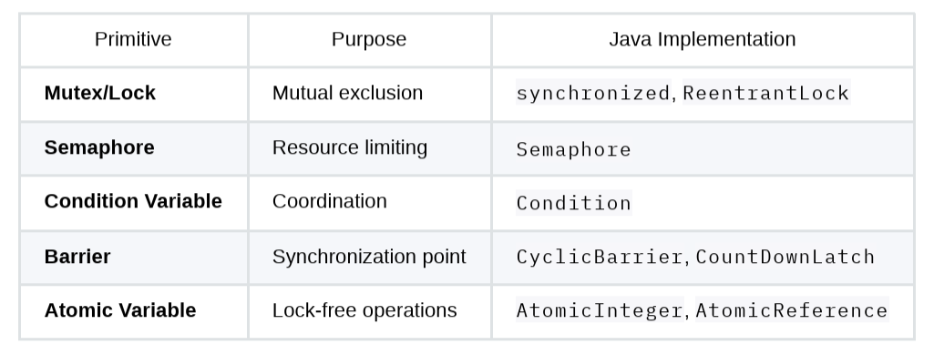
Lock objects

Slide 8
Threads – challenges
Resource A
Resource B
Raw threads have the following drawbacks:
Creating new thread for each task is expensive
No control over thread count
Difficult to manage lifecycle
Manual synchronization, that could bring to deadlocks
Thread X
Thread Y
Lock A
Lock B
Lock B
Lock A
If thread X and thread Y perform the two
A and B locks first, then we’re in a deadlock.

Slide 9
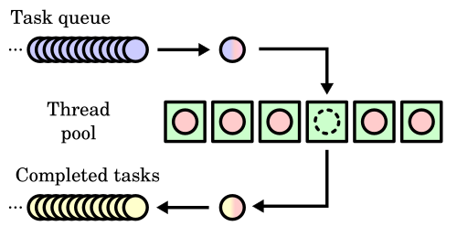
Thread management: thread pools & schedulers
Threads are already part of the pool, they are
pre-allocated and handled with the Executor
logic
for (Socket clientSocket : incomingConnections) {
// Too many context switches, memory pressure
new Thread(() -> {
handleClient(clientSocket);
}).start();
}
1-2 Mb per stack space, space wasted for TLS (Thread Local Storage),
too much context switch
import java.util.concurrent.*;
// Fixed-size thread pool
ExecutorService fixedPool = Executors.newFixedThreadPool(10);
// Cached thread pool (grows as needed, reuses idle threads)
ExecutorService cachedPool = Executors.newCachedThreadPool();
// Single-threaded executor (sequential task execution)
ExecutorService singlePool = Executors.newSingleThreadExecutor();
// Scheduled executor (tasks at specific times)
ScheduledExecutorService scheduled = Executors.newScheduledThreadPool(5);
Increase performance by reduced latency => no creation or destruction
Limit system load

Slide 10
Thread management: pools & schedulers - example
public class ExecutorPatternDemo {
public static void main(String[] args) throws InterruptedException {
ExecutorService executor = Executors.newFixedThreadPool(3);
// Submit multiple tasks
for (int i = 0; i < 10; i++) {
final int taskId = i;
executor.submit(() -> {
System.out.println("Task " + taskId +
" on thread " + Thread.currentThread().getName());
try {
Thread.sleep(1000);
} catch (InterruptedException e) {
Thread.currentThread().interrupt();
}
});
}
// Shutdown gracefully
executor.shutdown();
boolean terminated = executor.awaitTermination(30, TimeUnit.SECONDS);
if (!terminated) {
executor.shutdownNow(); // Force shutdown
}
}
}
Prepares a 3-threads pool
All other threads are put in a queue and scheduled when a thread from the pool is available

Slide 11
Futures
public class FutureCallableDemo {
public static void main(String[] args) throws Exception {
ExecutorService executor = Executors.newFixedThreadPool(2);
// Callable returns a result
Callable<Integer> task = () -> {
System.out.println("Computing...");
Thread.sleep(2000);
return 42;
};
// Submit task and get Future
Future<Integer> future = executor.submit(task);
System.out.println("Task submitted, doing other work...");
// Block until result is ready
try {
Integer result = future.get(5, TimeUnit.SECONDS);
System.out.println("Result: " + result);
} catch (TimeoutException e) {
System.out.println("Task took too long");
future.cancel(true); // Cancel task
}
executor.shutdown();
}
}
A Future represents the result of an
asynchronous computation.
When you fetch the result, if not available
yet, the calling thread will block.
Some frameworks/languages allow to cancel
them.
(JS Promises cannot be cancelled).

Slide 12
Fork-join
public static void main(String[] args) {
int[] array = new int[10000];
for (int i = 0; i < array.length; i++) {
array[i] = i + 1;
}
ForkJoinPool pool = new ForkJoinPool();
Long result = pool.invoke(new SumTask(array, 0, array.length));
System.out.println("Sum: ” + result);
}
}
import java.util.concurrent.ForkJoinPool;
import java.util.concurrent.RecursiveTask;
public class ForkJoinExample {
static class SumTask extends RecursiveTask<Long> {
private int[] array;
private int start, end;
private static final int THRESHOLD = 100;
public SumTask(int[] array, int start, int end) {
this.array = array;
this.start = start;
this.end = end;
}
@Override
protected Long compute() {
if (end - start <= THRESHOLD) {
// Base case: compute directly
long sum = 0;
for (int i = start; i < end; i++) {
sum += array[i];
}
return sum;
} else {
// Divide: create subtasks
int mid = (start + end) / 2;
SumTask left = new SumTask(array, start, mid);
SumTask right = new SumTask(array, mid, end);
// Fork subtasks
left.fork();
right.fork();
// Join results
long leftResult = left.join();
long rightResult = right.join();
return leftResult + rightResult;
}
}
}
0 - 9999
0 - 4999
5000 - 9999
0 - 2499
2500 - 4999
5000 - 7499
7500 - 9999
0 - 99
4899 - 4999
5000 - 5099
9899 - 9999
Recursively divide work into smaller subtasks, process in parallel, join results.

Slide 13
Active Object Pattern
class ActiveObject<T extends MyInterface> implements MyInterface {
private T sourceObj;
private Thread t;
private BlockingQueue<Runnable> dispatchQueue =
new LinkedBlockingQueue<Runnable>();
public MyActiveObject(T sourceObj) {
this.sourceObj = sourceObj
this.t = new Thread (new Runnable() {
@Override
public void run() {
try {
while (true) {
dispatchQueue.take().run();
}
} catch (InterruptedException e) {
// okay, just terminate the dispatcher
}
}
});
this.t.start();
}
@Override
public void doA() {
dispatchQueue.put(new Runnable() {
@Override
public void run() { t.sourceObj.doA(); }
});
}
@Override
public void doB() {
dispatchQueue.put(new Runnable() {
@Override
public void run() { t.sourceObj.doB(); }
});
}
public void stop() {
this.t.interrupt();
this.t.join();
}
}
The active object design pattern decouples method execution
from method invocation for objects that each reside in their
own thread of control.
interface MyInterface {
void doA();
void doB();
}
class MyClass implements MyInterface {
@Override
public void doA() { // whatever
}
...
}
MyClass mc = new MyClass(); ActiveObject< MyInterface> ao = new ActiveObject<>(mc);
executor.submit(() -> {
ao.doA();
});
executor.submit(() -> {
ao.doB();
});

Slide 14
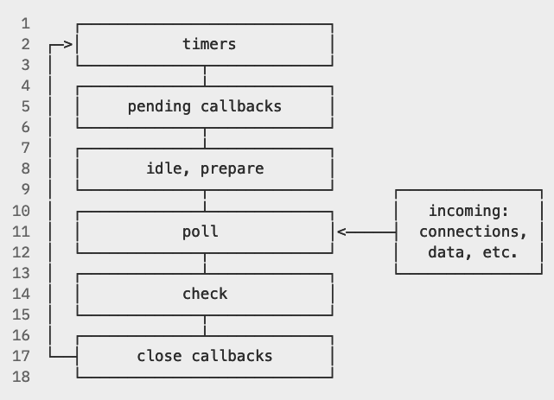
Reactor Pattern
The reactor pattern is an event handling strategy that can respond to many potential service requests concurrently.
The pattern's key component is an event loop, running in a single thread or process, which demultiplexes incoming
requests and dispatches them to the correct request handler.
while (!program_terminated) {
message = get_message_from_queue();
process_message(message);
}
setTimeout(() => {
// This is executed in the event loop
console.log('World!');
}, 1000);
// This is executed first
console.log('Hello’);

Slide 15
Reactor Pattern => only concurrency, not parallelism!!!
async function arraySum(values: number[]): Promise<number> {
return Promise.resolve(values.reduce((acc, val) => acc + val, 0));
}
const table: number[][] = [
Array.from({length: 100}, (x, i) => i),
Array.from({length: 300}, (x, i) => i + 1000),
Array.from({length: 2000}, (x, i) => i -10000)
];
const values = await Promise.all(table.map((arr) => arraySum(arr)));
import * as fs from "node:fs/promises";
fs.readFile("big_file_1.txt").then((content) => {
// parse content
});
fs.readFile("big_file_2.txt").then((content) => {
// parse content
});
We’re NOT running three threads in parallel here!!!
This code is CPU-bound only, there’s no I/O subsystem involved.
As the event loop is single-threaded,
each async is executed one after the other.
This code runs in parallel in the I/O
subsystem, BUT the two future callbacks will be executed sequentially, according to which file will be completed first.
To run something really in parallel, you need JS Workers.

Slide 16
Takeaways
Use thread pools => Avoid thread creation overhead
Prefer immutability => Eliminate synchronization needs
Use high-level concurrency APIs => Fewer bugs than low-level locks
Limit concurrency => Prevent resource exhaustion
Use scoped resource => Guarantee resource cleanup
Use virtual threads => Scale to millions of threads (if allowed by the runtime)

